Slide 1
Ch. 2: Population
September 8, 2014

Slide 2
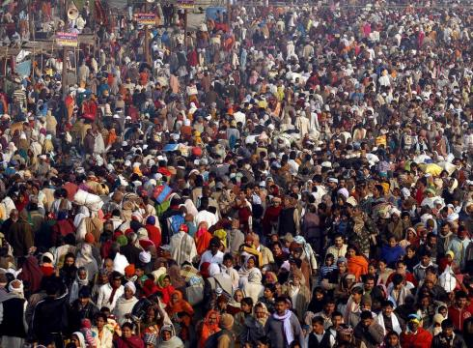
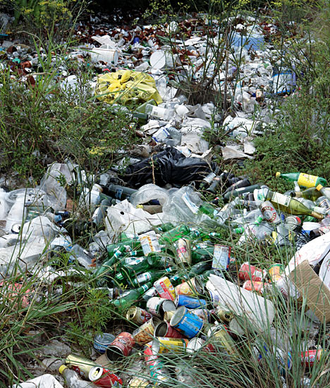
Why we study population
Total impact = impact per person * # people
=
x

Slide 3
Largest Population
#1: China
#2: India
#3: United States

Slide 4
Demographics
Birth Rate: how fast new babies are being born
Death Rate: how fast people are dying
Growth Rate: Birth Rate minus Death Rate
When will we achieve zero growth rate? Growing? Declining?

Slide 5
Demographics
Infant Mortality Rate: How many infants (under age 1) survive
Life expectancy: How long a child that is born can expect to live
Total Fertility Rate: Average number of children a mother will have
In America, it is about 2.1

Slide 6
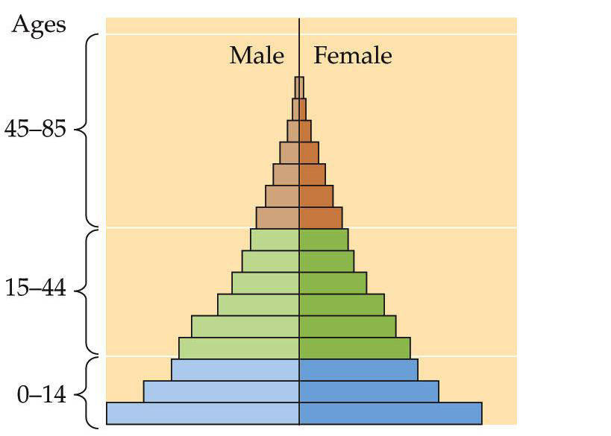
Reading Age Structures

Slide 7
Reading Age Structures

Slide 8
Stages of human growth
Stage 1: hunters & gatherers, population less than a few million
Stage 2: With the rise of agriculture led to the first major increase
Stage 3: Industrial Revolution, with improvements made to healthcare and supply of food, led to rapid increase
Stafe 4: Today, rate of population has slowed in wealthy countries, but still rapidly in poorer ones

Slide 9
History of Human Growth

Slide 10
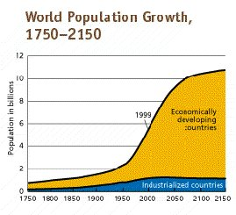
Exponential Growth

Slide 11
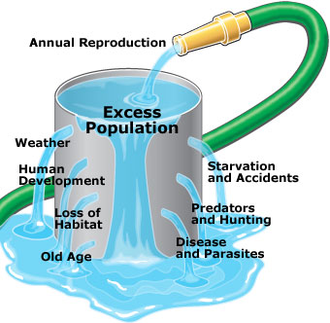
The Bad News
We can’t just keep growing exponentially forever
Eventually we will run out of food, space, and become more vulnerable to catastrophes.

Slide 12
THE GOOD NEWS!
Growth Rate is declining (even though population is growing. It’s just not growing as quickly).

Slide 13
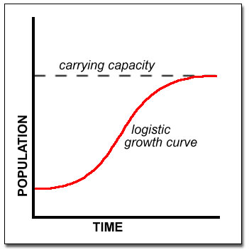
Logistic Growth
Eventually, we will see a smooth S-shaped curve known as a logistic growth curve
We will reach an upper limit, called the logistic carrying capacity.
This has been tested on many animal populations, and should hold true for human population as well.

Slide 14
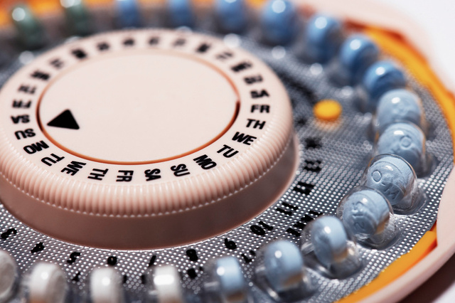
Way to slow down population growth?
Birth Control & Family Planning as an answer?
Specifically in third world countries
Write down some pros & some cons to this solution in your notes. Be prepared to share.

Slide 15
Tomorrow
Debate regarding birth control as an effective measure of regulating population

