Slide 1
Measurement
September 8, 2014

Slide 2
Before we get started…
Theory: well-tested explanation for a wide range of observations or experimental results
Future evidence may not support this theory

Slide 3
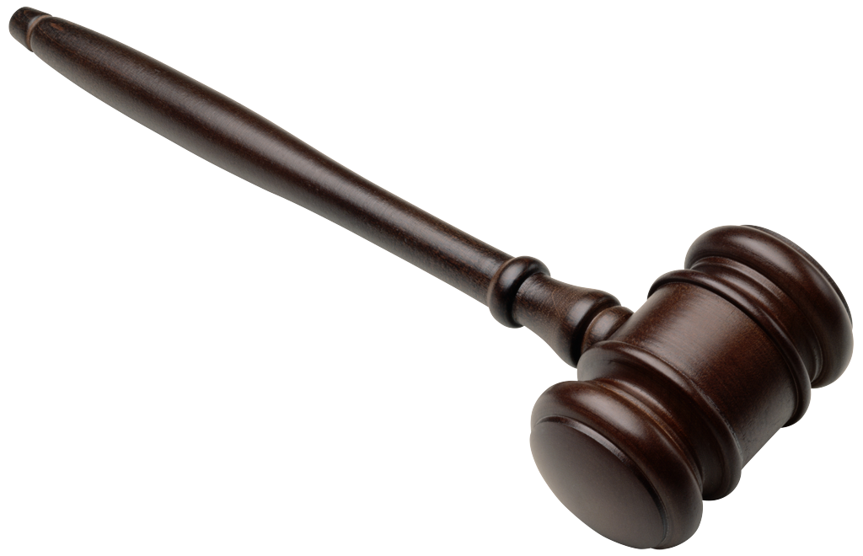
Before we get started…
Law: A statement that describes what scientists expect to happen every time under a particular set of conditions
Ex: Gravity

Slide 4
What is Matter?
Matter is anything that occupies space
Notes:
Is water matter, Class?
Is a rock matter, class?
Is light matter, class?
Is air matter, class?

Slide 5
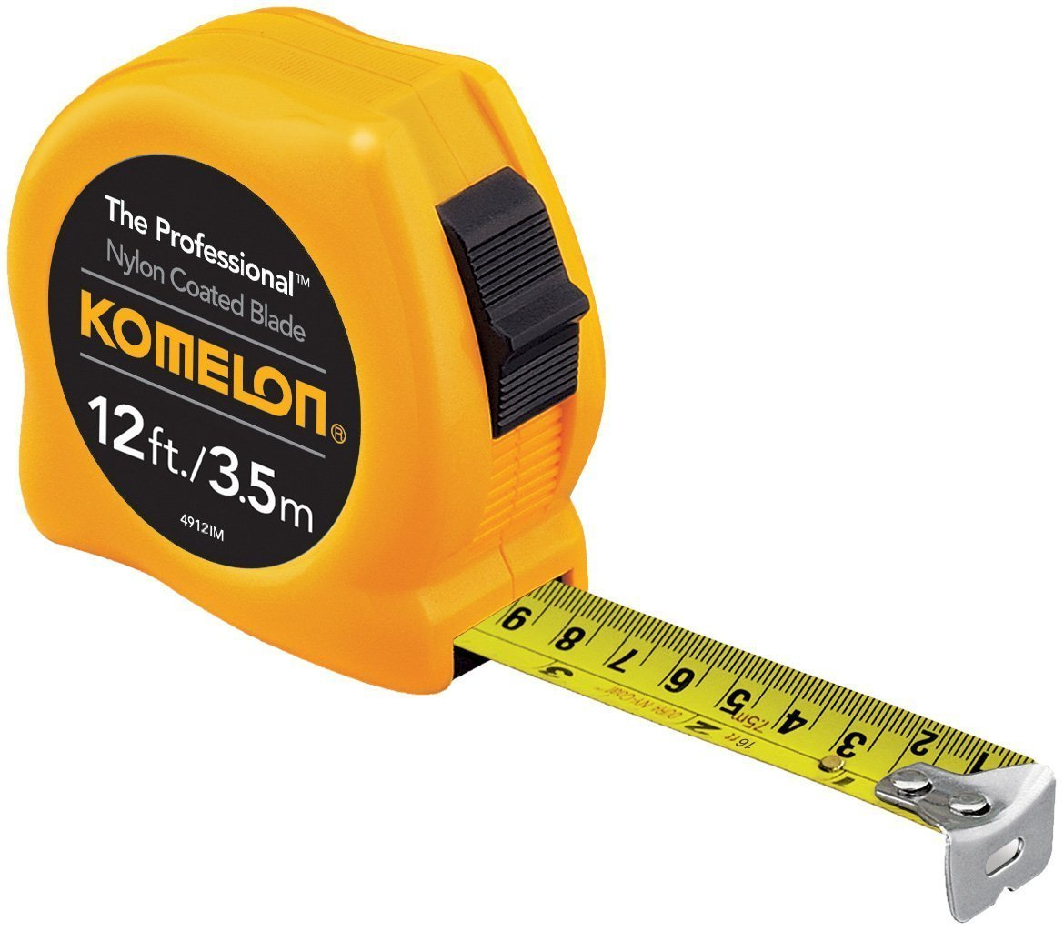
Measurements
In science, we use SI units.
Using the SI as the standard system of measurement allows scientists to compare data and communicate with each other about their results

Slide 6
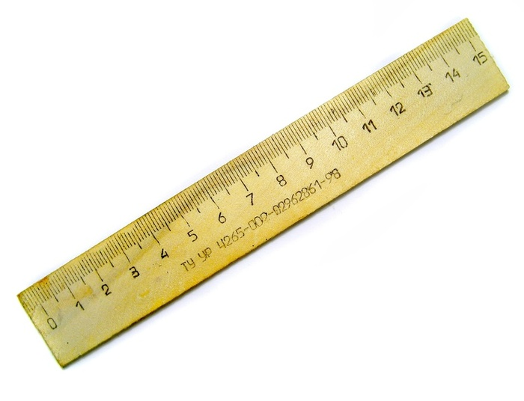
Length
Base unit = Meters (m)
1 Kilometer (km): 1000 m
1000 millimeters (mm) = 1 m

Slide 7
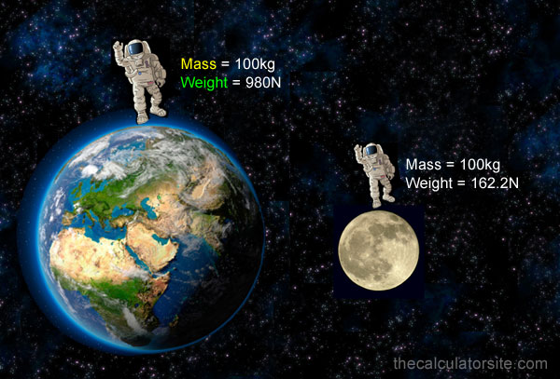
Weight vs. Mass
Weight: measures the force of gravity on you
Mass: measures the amount of matter of an object contains
Stays the same on different planets

Slide 8
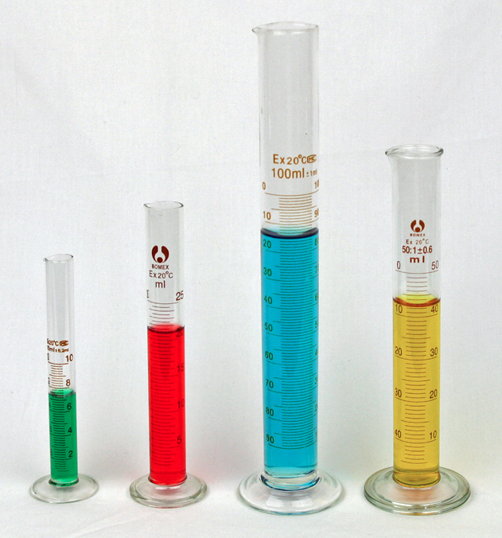
Volume
The amount of space that an object takes up
We will use liters (L) or milliliters (mL)
Meniscus

Slide 9
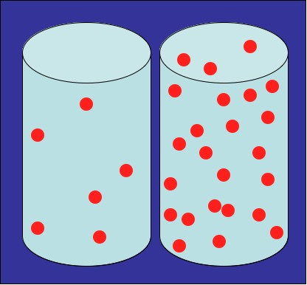
Density
Density = mass/volume

Slide 10
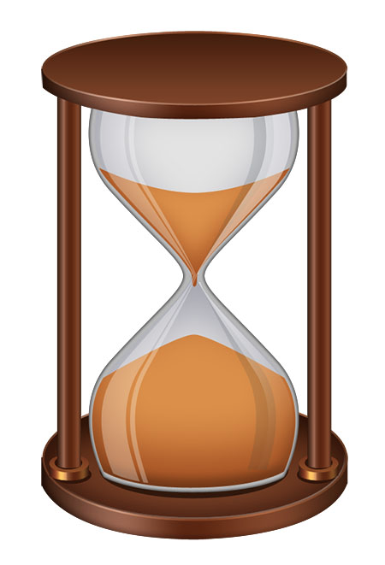
Time
SI unit is seconds (s)

Slide 11
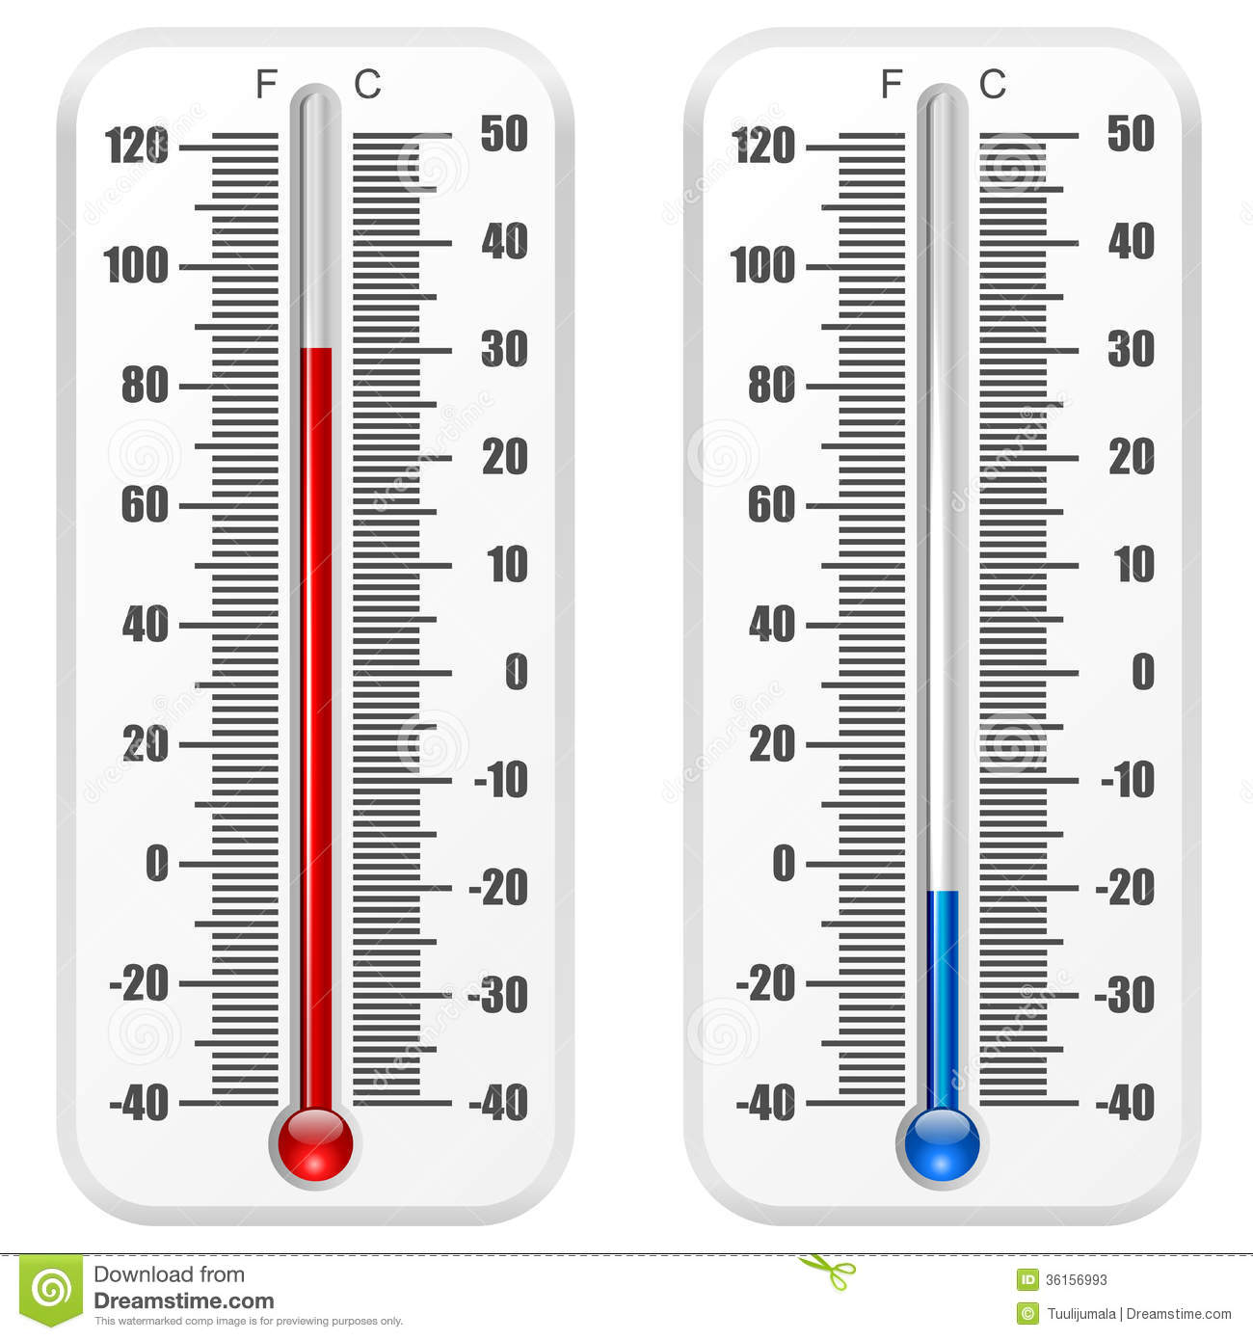
Temperature
Celsius (C)
Water freezes at 0 and boils at 100
Kelvin (K)

Slide 12
For Tomorrow…
Measurement Lab!

