Slide 1
What is environmental Science?
August 27,2014

Slide 2
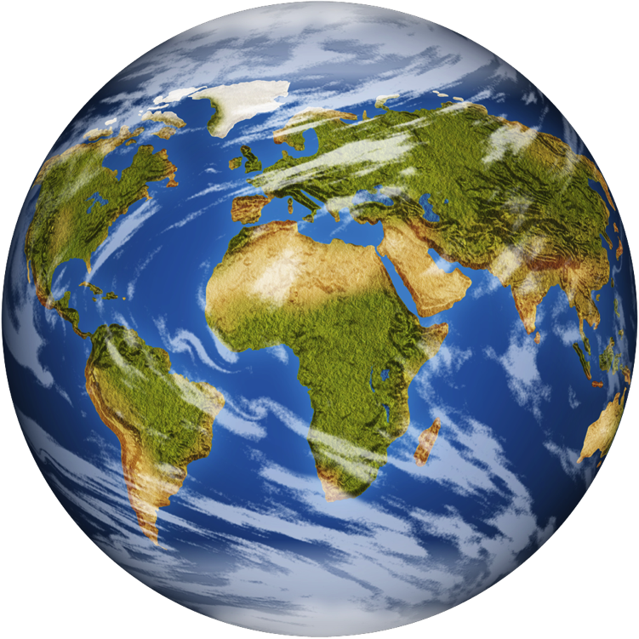
What is environmental Science?
Definition:
"the interdisciplinary study of humanity’s relationship with other organisms and the non-living physical environment"

Slide 3
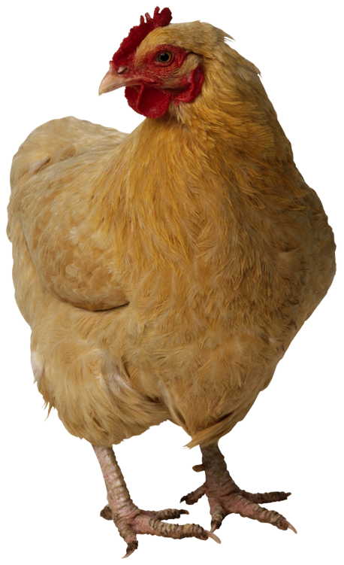
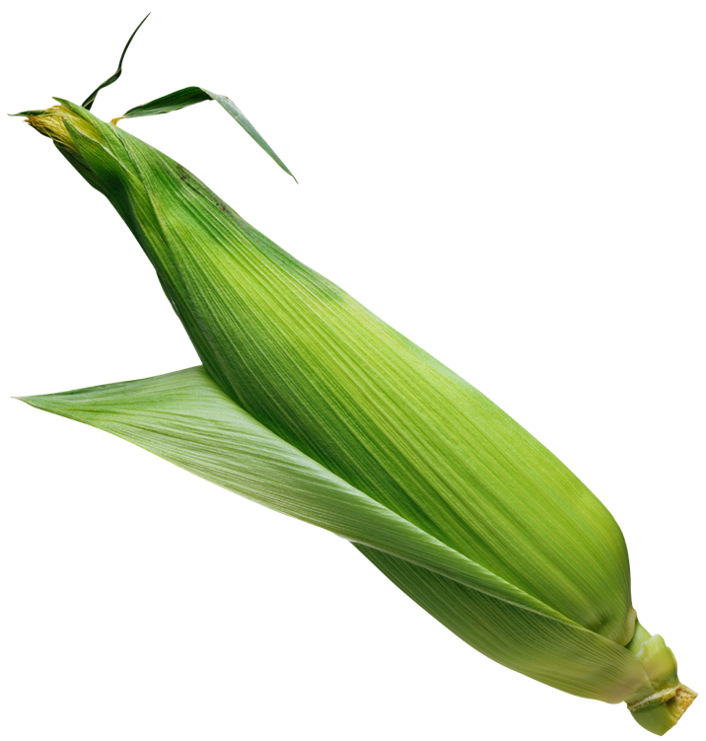
What is environmental Science?
interdisciplinary because it
uses & combines info from many disciplines
natural sciences: biology (ecology), geology, chemistry, physics
applied sciences: geography, agriculture, engineering
social sciences: economics, cultural anthropology, policy, politics, ethics, sociology

Slide 4
What environmental Science Is Not
we need to differentiate between
environmental science
"science" aspect is emphasized
environmental studies
"studying", becoming aware of current environmental issues, environmental ethics, environmentalism

Slide 5
Why is environmental Science Important?
Human domination of earth's ecosystems”
land surface has been transformed by human action
atmospheric CO₂ concentration has increased by ~30% since the beginning of the Industrial Revolution
more atmospheric nitrogen is fixed by humanity than all natural terrestrial sources combined
accessible freshwater is put to use by humanity
1/4 of bird species that ever lived on earth have been driven to extinction
2/3 of major marine fisheries are fully exploited, overexploited or depleted

Slide 6
Sustainability
Human population issues
Challenges and complexity

Slide 7
Quickwrite:
In the right margin, write about what sustainability (the ability to sustain) might mean.

Slide 8
Sustainability
"the ability of the environment to function indefinitely without going into a decline from the stresses imposed by human society on natural systems that maintain life"
enables humanity’s present needs to be met without endangering the welfare of future generations
applies at many levels
individual, community, regional, national, global

Slide 9
Sustainability
most experts believe environmental sustainability is not currently being achieved because
non-renewable resources (such as fossil fuels) are being used as if supplies were unlimited
renewable resources (such as fresh water) are being used faster than they can be replenished naturally
pollutants & toxins are being released into the environment as if environment’s capacity to absorb them was unlimited
human numbers continue to grow despite earth’s finite ability to support us

Slide 10
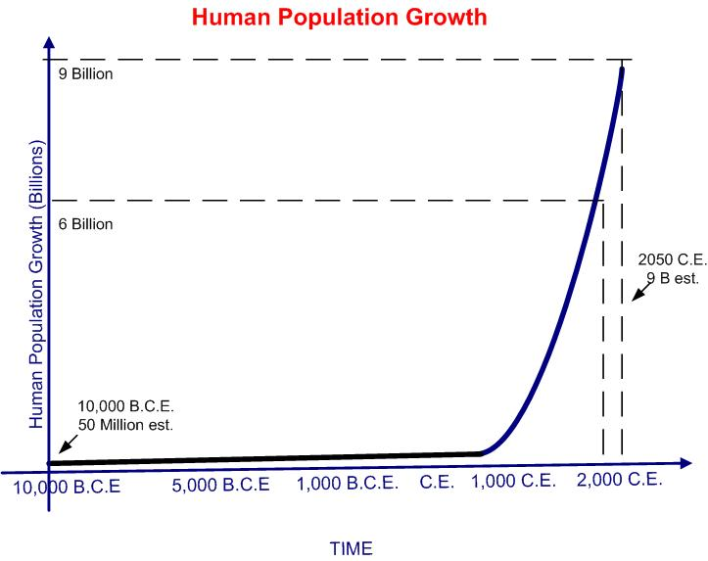
Human Population issues
Human population surpassed 6 billion in 1999
Currently at 7 billion
placing unsustainable stresses on the environment
consuming more food and water
using more energy and raw materials
producing more waste and pollution
World Bank estimates that 1.3 billion people live in poverty
unable to meet their basic needs for food, shelter, clothing

Slide 11
Challenges and complexity
issues may seem simple
why don’t we just stop over-consumption, population growth and pollution?
Solutions are challenging & complex because of
multifaceted interactions between ecological, social, cultural and economic factors
inadequate scientific understanding of how
the dynamic environment works
how different human choices affect the environment

Slide 12
Commercial Fisheries

Slide 13
Drought

Slide 15
Global Warming

Slide 16
Food Production

